Slide 1
BEEF CATTLE FATTENING USING FODDER BASED RATION (FBR)
Dube.S, Mkhombe. R, Thwala.M, Lukhele.A, Sihlongonyane. M and Sihlongonyane.N.

Slide 2
PRESENTATION OUTLINE
INTRODUCTION
MATERIALS AND METHODS
RESULTS AND DISCUSSIONS
CONCLUSION
RECOMMENDATIONS

Slide 3
1. INTRODUCTION
Feed-lotting is the feeding of beef cattle with a protein balanced, high-energy diet under confinement to increase live weights and improve degree of finish and thus obtain better grades at the abattoir.
Agro-industrial by-products, fodder crops and crop residues represent a vast animal feed resource, which is as yet largely unexploited in Swaziland.
Ration formulation is the process of combining an assortment of feed ingredients into a ration that will meet the nutrient requirements of animals for the intended purpose of production.
The ration must be balanced in such a way that it provides amongst others: sufficient quantity of energy yielding nutrients, quantity and adequate quality of proteins and bulk or roughage for normal rumen function.

Slide 4
Objective of this study was to
Examine the growth response of local cattle breeds finished on fodder based rations from weight of entry to weight at marketing and to identify constraints so that improvement strategies might be formulated.
The research has been, and is being carried out on the potential of by-products, fodder crops and crop residues and to exploit their use on feedlot animal’s nutrition.

Slide 5
2. MATERIALS and METHODS
Research was conducted at 3 Farmer companies
Animals sourced from individual farmers at agreed price kg.
Animals were weighed, dewormed and vaccinated on entry in to the feedlot.
The groups of feeder cattle were assigned to a dietary treatment and fed at ad libitum
Dietary treatments were:
Lucerne
Cowpeas
Yellow maize and stalks
Chicken litter
Molasses

Slide 6
Nutritional Content of feeds
Feed | Protein | Inclusion in the diet
Lucerne | 18.3 | 15%
Cowpeas | 18.1 | 15%
Yellow maize and stalks | 9.4 | 54%
Chicken litter | 24.2 | 15%
Molasses | 5.5 | 1%

Slide 7
3. RESULTS AND DISCUSSION

Slide 8
Production and Profitability Analysis: Actuals & Projections
Average per animal |  | Actuals |  |  | Projections
 |  | Demo Centre | Singeni | Nxutsamlo | Proj. FBR | Proj. CMR
Production | Initial Weight (kg) | 304.0 | 265.8 | 202.3 | 300.0 | 300.0
 | Final Weight (kg) | 337.0 | 308.0 | 305.3 | 384.0 | 399.0
 | Days on feedlot | 88.0 | 76.5 | 137.7 | 120.0 | 90.0
 | Daily weight gain(kg) | 0.38 | 0.55 | 0.75 | 0.70 | 1.10
Profitability | Selling price (SZL) | 5,933.9 | 5,452.8 | 5,401.3 | 8,448.0 | 8,778.0
 | Purchase price (SZL) | 4,187.5 | 4,251.3 | 3,366.7 | 4,500.0 | 4,500.0
 | Feed expenses (SZL) | 1,074.7 | 934.2 | 1,681.6 | 1,465.4 | 3,483.0
 | Labour cost (SZL) | 211.8 | 196.4 | 1,767.2 | 231.00 | 173.3
 | Profit/animal (SZL) | 460.0 | 71.0 | (1,414.1) | 2,251.6 | 621.8

Slide 9
Feed cost comparison; FBR vs CMR
Average per animal | FBR | CMR
Weight of feed (kg) | 8.6 | 8.6
Cost per kg (SZL) | 1.4 | 4.5
Cost per day (SZL) | 12.2 | 38.7

Slide 10
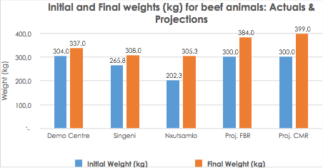

Slide 13
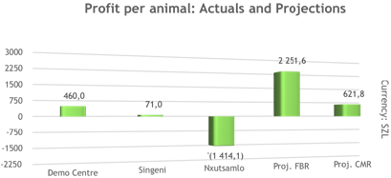

Slide 14
4. CONCLUSION
The optimal utilization of the fodder crops, even though the animals take quite longer to be ready for market and the weight gain per day lower than the commercial feed,
Considerably increase animal production,
Help to reduce the acknowledged animal protein deficit
Lower cost of feed production, thus resulting in improved net profits.

Slide 15
5. RECOMMENDATIONS
The feedlots must be stocked with at least 20 animals of about 300kg
Each animal must be bought at least at SZL 15/ live Kg and sold at about SZL 20/live Kg as per the projections.
One laborer must be hired to run each feedlot.
Feeding must be done on the same time each day.

Slide 16
THANK YOU

