Slide 1
“Smallholder Goat Farmers’ Market Participation in Choma District, Zambia”.
PRESENTATION BY HENRY CHIPASHA

Slide 2
PRESENTATION OUTLINE
Introduction,
Problem Statement,
Research question/objectives,
Research Methodology,
Study Findings
Conclusion & Recommendations

Slide 3
INTRODUCTION
‘Importance of the Livestock Sector’
30% GDP in SSA,
Provides livelihood to10% in SSA,
28% to agricultural GDP in Zambia,
38.7% livestock producing rural households.

Slide 4
PROBLEM STATEMENT
Despite the potential opportunities of the livestock sector,
Sector is yet to capture the benefits due to low levels of market Participation, poor market infrastructure, Lack of credit facilities,
No research conducted on live goat market chain in Choma.

Slide 5
RESEARCH QUESTION
What factors influence a smallholder goat farmer’s decision on the type of marketing channel to use?

Slide 6
RESEARCH OBJECTIVES
To identify actors, characteristics, functions, linkages, attitudes, habits & practices,
To establish main institutional & technical factors,
To identify key constraints & opportunities in production/marketing.

Slide 7
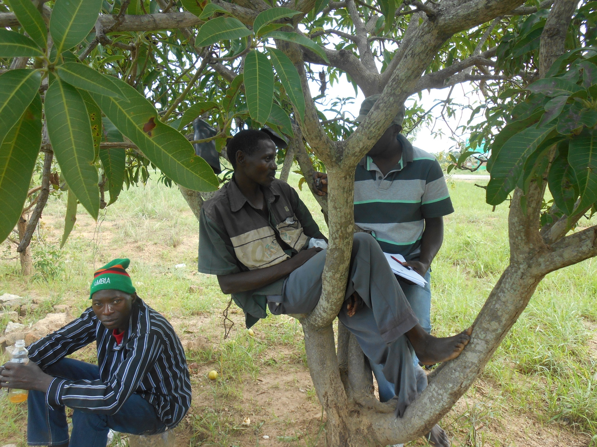
STUDY METHODOLOGY
Study location – Choma district in Southern Zambia,
54% households rear goats,
Two stage sampling procedure,
Systematic sampling,

Slide 8
STUDY METHODOLOGY
‘Data Collection’
Pre-structured questionnaire, interview guides,
110 HH surveyed,
2 FGDs with 7 smallholder goat farmers,
9 goat traders, 1 wholesaler.

Slide 9
STUDY METHODOLOGY
‘Data Analysis’
105 retained, Data cleaned using Excel,
Descriptive statistics (SPSS, version 20),
Market margins,
Kruskal – Wallis non-parametric Test (P = 0.05),
Chi-square test (P = 0.05).

Slide 10
RESEARCH FINDINGS
‘Sample Characteristics of Respondents’
65.4% - male ; 34.6% - female,
49% belong to age group 36 – 50 years,
39.4% rear 5 – 9 goats per year,
40.4% ; rearing goats 1 – 5 years.

Slide 11
RESEARCH FINDINGS
‘Goat Market Channels’
Farmer – Urban Trader Channel,
(61.5%)
Farmer – Rural Trader Channel,
(20.2%)
Farmer – Trader Choma Market.
(18.1%)

Slide 12
REASONS FOR PREFERRED CHANNEL

Slide 13
PRODUCTION & MARKETING CONSTRAINTS
Production & Marketing Constraints | Strongly Disagree 1 | 2 | 3 | 4 | Strongly Agree 5
Distance to Market | 7.6 | 1.9 | 2.9 | 7.6 | 79.0
High transportation costs | 8.6 | 1.9 | 4.8 | 6.7 | 77.1
Lack Vet Services | 22.0 | 11.0 | 8.0 | 9.0 | 54.0
High input prices | 14.3 | 7.6 | 10.5 | 18.1 | 49.5

Slide 14
MARKET MARGINS
Market Channel | Average Selling Price/goat | Average Production cost/goat | Transaction Costs/goat | Market Margin/goat
Existing Market Channels
Farmer - Urban Trader | 170 | 34.51 | 0.00 | 135.49
Farmer - Rural Trader | 110 | 34.51 | 0.00 | 75.49
Farmer - Trader Choma Market | 130 | 34.51 | 33.00 | 62.49

Slide 15
FACTORS AFFECTING CHOICE OF MARKET CHANNEL
Variables | χ 2 -value | df | P-value | Decision
Experience in goat farming (Years) | 1.694 | 2 | 0.429 | Not significant
Herd size | 0.256 | 2 | 0.880 | Not significant
Total income (ZMK) | 4.015 | 2 | 0.135 | Not significant
Total farm size (Ha) | 0.007 | 2 | 0.997 | Not significant
Cost of production (ZMK) | 8.983 | 2 | 0.011 | SIGNIFICANT

Slide 16
FACTORS AFFECTING CHOICE OF MARKET CHANNEL
Variables | χ2 | P - value | Decision
Age | 5.819 | 0.213 | Not significant
Gender | 1.493 | 0.474 | Not significant
Level of education | 7.771 | 0.255 | Not significant

Slide 17
CONCLUSIONS
Agro shops > Goat farmers > Traders > Wholesalers > Retailers > Consumers,
High disease prevalence, Distance to market,
Profitable,
Cost of production affects Market Chanel .

Slide 18
RECOMMENDATIONS
Production
Drugs
Veterinary Services
Production Skills

Slide 19
RECOMMENDATIONS
Marketing
Market infrastructure
Marketing skills
Access to information
Group marketing

Slide 20
REFERENCES
Adesehinwa, AOK, Okunola, JO & Adewumi, MK 2004, ‘Socio-economic characteristics of ruminant livestock farmers and their production constraints in some parts of South-western Nigeria’, Livestock Research for Rural Development, vol. 16, no. 61, May 4, 2014, http://www.lrrd.org/lrrd16/8/ades16061.htm.
Agriculture and Rural Development 2009, ‘Zambia commercial value chains in Zambian agriculture: do smallholders benefit?’ Sustainable Development Department, Zambia, viewed 28 August 2013, https://openknowledge.worldbank.org.
Ajala, MK & Adesehinwa, AOK 2007, ‘Roles and efficiency of participants in pig marketing in the northern part of Nigeria’, Journal of Central European Agriculture, vol. 8, no.3, pp. 311 – 326.
Beneberu, T, Lemma, WY, Shenkute, G, Aschalew, T, Solomon, G, Getachew, L, Duncan, AJ, & Thorpe, W 2012, ‘Sheep and feed value chain analysis in North Shewa, central highlands of Ethiopia, International Livestock Research Institute, Addis Ababa, Ethiopia.
Boogaard, BK, Hendrickx, SCJ & Swaans, K 2012, ‘Characterization of smallholder goat production and marketing systems in Inhassoro District, Mozambique: Results of a baseline study’, International Livestock Research Institute, Addis Ababa, Ethiopia.
Central Statistical Office /Food Security Research Programme 2000, Post Harvest Survey and Supplemental Surveys 2001, 2004, and 2008, FSRP, Lusaka, viewed 28 July 2013, http://www.aec.msu.edu/fs2/zambia/index.html.
Central Statistical Office 2003, ‘Agriculture Analytical Report for the 2000 Census of Population and Housing’, Central statistical office, Lusaka, viewed 29 July 2013, www.zamstats.gov.zm.

Slide 21
THE END
THANK YOU

