Slide 1
Analysis Of Beef Cattle Value Chain In The Forest-Savannah Transitional Zone Of Ghana
International Conference on Livestock Value Chain Finance and Access to Credit
Royal Swazi Spa- Ezulwini, Swaziland
21-23 February, 2017
Paper prepared by :
Owusu C., Mensah-Bonsu A., Amegashie D.P.K., Kuwornu J.K.M
DATE: 21ST FEBRUARY, 2017.

Slide 2
OUTLINE OF PRESENTATION
Introduction
Problem Statement
Methodology and Methods
Results and Discussion
Summary and Conclusion
Policy Recommendation
References

Slide 3
INTRODUCTION
The livestock sub- sector plays an integral role in the Ghanaian economy.
The sector has contributed significantly in:
Supplying animal protein to the entire population
Providing draught power for crop production
Manure to fertilize soil
Cash income.
Available data shows that livestock sub-sector contributes 7.5% of the total agricultural GDP (MOFA/SRID, 2012)

Slide 4
Introduction Cont’d
Beef alone contributes slightly more than 30% of Ghana’s meat requirements.
Available statistics show that 21,221 metric tonnes of beef were produced from a total of 220,446 cattles that were slaughtered (MOFA, 2012).
However, to reduce this low trend of production and marketing, efforts should be exerted towards the beef cattle value chain development.

Slide 5
Problem Statement
The beef cattle industry remains a key livestock component with significant contribution to food security and income in pastoral communities (FAO, 2010; ILRI, 2007).
Yet demand for beef far exceed supply in the market.
Therefore livestock farmers and other stakeholders can take advantage to increase production level and participate in the market to increase value addition and profit margin
At the production level of the chain, constraints identified by researchers include: feed scarcity,
low prolificacy and poor feed conversion efficiency,
high cost of input and veterinary services,
high mortality rate,
diseases and pest infection
and theft ( Adzitey 2013).

Slide 6
Problem Statement
Their inability to create the needed value has led to non- improvement in current production, processing and marketing in the Ghanaian beef cattle chain .
Consequently, these constraints have also resulted in low productivity, increase poverty and relatively have lowered margin of value chain actors.
Though, there are abundant agricultural activities, developing efficient marketing strategies for the supply of beef cattle is necessary to manage the animals for high off-take and maximize their value for meat production.
Other technical and institutional factors that affect value chain actors participation in the market include;
Information asymmetry,
inadequate market infrastructure,
lack of access to credit,
high transaction cost e.t.c .
Therefore, understanding value chain approach will be crucial to understand the sources of the problems and recommend viable options to overcome the problems and improve the production and marketing of value added products.

Slide 11
RESEARCH OBJECTIVES
The objective of the study is in threefold
To map and describe the chain actor, their marketing activities, roles and marketing channel.
To estimate value added and profit margin of each actor along the main chain.
To identify and rank the constraints of the value chain actors in the study area.

Slide 12
Methodology
The research was conducted in the Forest- Savannah transitional zone.
Both the qualitative and quantitative research design was employed in the data collection.
Target population was all cattle farmers in the study area
Intermediate actors like the butcher, collector/ wholesaler, as well as beef processors were considered.
Two- stage random sampling technique was used
Snow- ball sampling was used to select the intermediate actors
200 respondents were sampled which includes:
80 producers, 40 collectors/ Wholesalers, 40 Butchers and 40 Beef processors.

Slide 13
Method of Analysis
Objective 1: Mapping and description the chain actor, their marketing activities, roles and marketing channel:
The source, make and delivery approach was adopted by Foreign Investment Advisory Service (2007).

Slide 14
Method of Analysis
Objective 2: In estimating the value addition and margins, the gross margin analytical technique was used. And simplified below in the table 1
Source: Van den Berg et al. (2008); Kuwornu et al. (2013). N = UNIT VC, Value added= unit selling price-cost of primary input.
Actors | Costs (GHȻ)/Kg |  |  |  | Revenue (GHȻ) /Kg |  |  |  | Margin (GHȻ) /Kg
 | Total cost | Cost of primary inputs | Added unit cost | % Value unit cost | Unit price | Unit profit | Value Added | % Total chain profit | Unit Gross chain margin | % Gross chain margin
Producers | A | B | A-B | (A-B)/O | C | C-A | C-B | (C-A)/P | C-N | C-N/Q
Collector/Wholesaler | E | D | E-D | (E-D)/O | F | F-E | F-D | (F-E)/P | F-N | C-N/Q
Butchers | H | G | H-G | (H-G)/O | I | I-H | I-G | (I-H)/P | 1-N | C-N/Q
Processors | K | J | K-J | (K-J)/O | L | L-K | L-J | (L-K)/P | L-N | C-N/Q
Total |  |  | O | 100 |  | P |  | 100 | Q | 100

Slide 15
Method of Analysis cont’d
ROI = $\frac{Po−Co}{Co}$ Where
ROI is Return on Investment
Po is the value of one unit of output
Co is Unit cost in producing an output.
Estimating the Return on Investment per Day
Calculating the return on investment per day is given
ROID= $\frac{ROI}{Time in generating profit}$
Where:
ROID is return on investment per day
Time is measured in days.

Slide 16
Method of Analysis cont’d
Objective 4: Identification and ranking of constraints:
The Kendell’s co-efficient of Concordance was used
The formulae is represented as W = $\frac{12 \left[ΣT2−\frac{\left(ΣT\right)2}{n}\right]}{m2n\left(n2−1\right)}$
Where: W= Kendall’s coefficient of concordance, T= sum of ranks for each constraint being ranked, m= number of respondents n= number of ranking.
Hypothesis
H₀: There is no agreement among the ranking of constraints.
H₁: There is agreement among the ranking of constraints.

Slide 17
RESULTS AND DISCUSSION
Objective 1:
Fig 1:Flow Chart of Beef Value Chain in the Forest- Savannah Transitional Zone
Function
Actors
Service
Providers
10%
Individual consumers and Household. Grilled, roasted and cooked Beef
100%
Consumption
Financial Institution, Transporters, Government regulatory bodies,
Professional Association
Veterinary officer
Extension agent
Research Institution
Training and Education
Processing
40%
Secondary beef processors i.e. khebab sellers (beef cuts, sausages, offals etc.)
60%
20%
Slaughtering
Abattoirs and Informal Slaughter houses
70%
Private butcheries
50%
Fattening
Traditional fattening
10%
Commercial Feedlot
Distribution and Marketing
Collector/Wholesaler
Production
40%
Source: Field data, 2016.
Small scale agro pastoralists and Pastoralists
INPUT SUPPLY
Suppliers of breeding stock, veterinary drugs and feed supplements
Chart Legend: Physical flow of Products. Producers Traders (Collectors &Wholesalers) Butchers Processor
potential linkages and actors

Slide 18
Results and discussion cont’d
Table 2: Beef Cattle Marketing Information among Actors in the chain
Source: Field Survey (2016).
Variable | Producer |  | Trader |  | Butcher |  | Processor |  | Pooled
 | Freq | % | Freq | % | Freq | % | Freq | % | Freq | %
Mode of transportation
Truck | 6 | 7.5 | 15 | 37.5 | 1 | 2.5 | - |  | 22 | 11
Tricycle | 68 | 85 | 15 | 37.5 | 14 | 35 | 40 | 100 | 137 | 68.5
Motorcycle | 4 | 5 | - |  | - |  | - |  | 4 | 2
Pick-up/ vehicle | 1 | 1.3 | 10 | 25 | - |  | - |  | 11 | 5.5
On foot/ wheel barrow | 1 | 1.3 | - |  | 25 | 62.5 | - |  | 26 | 13
Mode of sales
By weight | 1 | 1.3 | 1 | 2.5 | 40 | 100 | - |  | 42 | 21
By physical examination | 79 | 98.8 | 39 | 97.5 | - |  | - |  | 118 | 59
By count | - |  | - |  | - |  | 40 | 100 | 40 | 20
Form of payment
Spot cash | 67 | 83.7 | 27 | 67.5 | 21 | 52.5 | 40 | 100 | 155 | 77.5
Credit payment | 13 | 16.3 | 13 | 32.5 | 19 | 47.5 | - |  | 45 | 22.5
Main reasons for sale of main product
Business | 45 | 56.2 | 40 | 100 | 40 | 100 | 40 | 100 | 165 | 82.5
Household expenses | 27 | 33.8 | - |  | - |  | - |  | 27 | 13.5
Social obligations/ceremonies | 8 | 10 | - |  | - |  | - |  | 4 | 4
Total (N) | 80 |  | 40 |  | 40 |  | 40 |  | 200

Slide 19
Results and discussion cont’d
Table 3: Sources of Market Information by Actors of Beef Cattle Value Chain
Source: field survey, 2016
Variable | Producer |  | Trader |  | Butcher |  | Processor |  | Pooled
 | Freq | % | Freq | % | Freq | % | Freq | % | Freq | %
Market information
Yes | 47 | 58.8 | 34 | 85 | 33 | 82.5 | 13 | 32.5 | 127 | 63.5
No | 33 | 41.3 | 6 | 15 | 7 | 17.5 | 27 | 67.5 | 73 | 36.5
Source of market availability information
Friends | 42 | 89.4 | 21 | 61.8 | 17 | 51.5 | 13 | 100 | 93 | 79.5
Radio | 5 | 10.6 | 4 | 11.8 | - |  | - |  | 9 | 7.7
Association | - |  | 9 | 26.4 | 16 | 48.5 | - |  | 15 | 12.8
Government agencies | - |  | - |  | - |  | - |  | -
Total(N) | 80 |  | 40 |  | 40 |  | 40 |  | 200

Slide 20
Table 4: Credit access among beef value chain actors
SOURCE OF CREDIT ACCESS | PRODUCER | TRADER | BUTCHER | SECONDARY PROCESSOR
Non- formal (Friends and relatives) | 23.5 | 12.5 | 7.5 | nil
Formal institution | nil | nil | nil | nil

Slide 21
Table 5. Summary of value addition and Margin of Actors in the Beef Cattle Value Chain Analysis
Beef value actors | Costs (GHȻ)/Kg |  |  | Revenue (GHȻ) /Kg |  |  |  | Margin (GHȻ) /Kg
 | Unit Total cost | Cost of primary inputs | Added unit cost | Unit price | Value Added | Unit profit | % Unit profit | Unit Gross chain margin | % Gross chain margin
Farmers | 14.39 | 10.00 | 4.39 | 15.10 | 5.10 | 0.71 | 18.02 | 4.14 | 55.42
Collector/ Wholesaler | 16.45 | 15.31 | 1.14 | 17.42 | 2.11 | 0.97 | 24.62 | 0.97 | 12.98
Butchers | 16.06 | 15.59 | 0.47 | 17.45 | 1.86 | 1.39 | 35.28 | 1.39 | 18.61
Secondary Processors | 24.63 | 16.80 | 7.83 | 25.50 | 8.70 | 0.87 | 22.08 | 0.97 | 12.98
Total |  |  | 13.83 |  | 17.77 | 3.94 | 100.00 | 7.47 | 100.00
Source:field data, 2016.

Slide 22
Table 6: Results on Return on Investment per Day (ROID)
Source: field survey, 2016.
Actors | Unit profit(GHȻ) | Unit TC(GHȻ) | ROI (%) | Days | ROID
Producers | 0.71 | 14.39 | 4.93 | 1095 | 0.005
Collector/Wholesalers | 0.97 | 16.45 | 5.90 | 7 | 0.843
Butcher Secondary Processors | 1.39 | 16.06 | 8.66 | 1 | 8.660
Secondary processor | 0.87 | 24.63 | 3.53 | 1 | 3.530

Slide 23
Table 7: Shows The Marketing Constraints Of The Various Value Chain Actors
Marketing Constraint | Mean Score | Rank
Beef cattle trader
High transportation cost | 3.88 | 1
High purchasing material cost | 3.75 | 2
Poor market infrastructure | 3.72 | 3
Inadequate credit | 3.65 | 4
Unsatisfactory market price | 3.46 | 5
Theft incidence | 3.43 | 6
Poor handling of Cattle | 3.25 | 7
Butcher
High material cost | 4.6 | 1
High slaughtering cost | 4.58 | 2
High transportation cost | 3.03 | 3
Lack of ready market | 2.8 | 4
Lack of access to market information | 2.78 | 5
Inadequate storage facilities | 2.78 | 5

Slide 24
Table 7: Marketing constraints among value chain actors cont’d
Beef Processors | Mean score | rank
High cost of material input | 4.22 | 1
High cost of processing | 3.9 | 2
Lack of ready available market | 3.38 | 3
High transportation cost | 3.08 | 4
Lack of access to market information | 2.75 | 5
Lack of access to credit | 2.13 | 6
Problem with storage | 1.97 | 7
Beef Producers
Poor market infrastructure | 4.13 | 1
High cost of transportation | 3.98 | 2
Unsatisfactory marketing prices | 3.46 | 3
Unavailable market information | 3.09 | 4
Source: field survey, 2016

Slide 25
Results and discussion cont’d
Source: field survey, 2016.
Estimate | Traders | Butchers | Processors | Producers
Sample size | 40 | 40 | 40 | 80
Kendell's W | 0.21 | 0.42 | 0.56 | 0.38
Chi-Square | 39.78 | 84.67 | 133.29 | 66.24
Degree of Freedom | 6 | 5 | 6 | 3
Asymptotic significant | 0.000 | 0.000 | 0.000 | 0.000

Slide 26
Summary &conclusion
The study assessed the beef cattle value chain to map and characterize the beef actors activities, role, and function in the forest-savannah transitional zone areas in Ghana.
Major core function of actor include production, distribution and marketing, Slaughtering, processing and consumption
Common market used was the spot market
Payment mode was commonly by cash
Mode of sale of live animal was by physical estimation.
Producer received the least profit of 0.71gh/kg, followed by processors 0.87gh/kg, then trader 0.97gh/kg and finally butcher received the highest unit profit 1.39gh/kg.
The study revealed that processors followed by producers added the largest value.
Butcher recorded the highest return on investment with a value of GHC 8.66, followed by traders GHC 5.90, then GHC4.93 by producers and lastly GHC 3.53 by processors.
The empirical results of the Kendall’s Coefficient of Concordance revealed that high cost of production inputs, poor market infrastructure, high cost of transportation and high material cost were ranked by the various actors to be the most pressing constraints.

Slide 27
Recommendation
The study recommend that public institutions should identify the beef sub-sector as a very important sector and take lead in promoting marketing and providing supportive infrastructures such as road network, transportation and others incentive regimes to attract the international market in future.
Department of Cooperatives and Farmer Based Association should encourage farmers to form competent marketing groups (cooperatives) which can be used as bargaining blocks to lobby for better prices.
The study again recommend that government through the sectorrr Ministry should roll up sensitization programme and conduct effective training for the actors in the entire value chain, especially farmers.
The study recommends the need for contract farming between value chain actors especially producers and NGOs or Government agencies to enhance value chain financing.
To ensure equity among value chain actors, the study recommend that standardized measuring scale should be made available to producers.
The study recommends that the state and development partners should provide capital support to make cattle business attractive to encourage young graduate to venture into butchery and meat processing.
Lastly, the study recommend the need to strengthen horizontal integration among the livestock value chain actors (i.e. farmers, butchers, traders and secondary processors).

Slide 28
Acknowledgement
The authors of this paper duly acknowledge our sponsors
CCLEAr Project
A. G. Leventis Fellowship Scheme
Government of Ghana
ILRI

Slide 29
References
Adzitey, F. (2013). Animal and meat production in Ghana-An overview. The Journal of World’s Poultry Research, 3, 01-04.
Ministry of Food and Agriculture (MOFA). (2012). Agriculture in Ghana, Facts and Figures. Statistics, Research and Information Directorate (SRID). Accessed May 2012, available at http://mofa.gov.gh/site/?page_id=6032.
Foreign Investment Advisory Services (FIAS), (2007). Moving Towards Competitiveness: A value Chain Approach. The World Bank Group. Washington D.C
FAO (2010). Status of and Prospects for Smallholder Milk Production – A Global Perspective, by T. Hemme and J. Otte. Rome.
ILRI (2007). Markets that work. Making a living from Agriculture, Nairobi Kenya, and Annual report. Improved Natural Resources Management Practices among Smallholder Farmers in Western Kenya. Food Policy, 32 (1); 151-536.
Kuwornu, J. K. M., Nafeo, A. A. and Osei-Asare, Y. B. (2013). Financial Viability, Value Addition and Constraint Analyses of Certified Organic Pineapple Production and Marketing in Ghana. African Journal of Basic & Applied Sciences, 5(1), 12-24.
Vermeulen, S., Woodhill, J., Proctor F.J. and Delnoye, R. (2008). Chain-wide learning for inclusive Agrifood Market Development. A guide to multi-stakeholder processes for linking small-scale producers to modern markets. IIED, UK, Wageningen University and Research Centre, Netherlands. ISBN 978-90-8504-964-7.

Slide 30
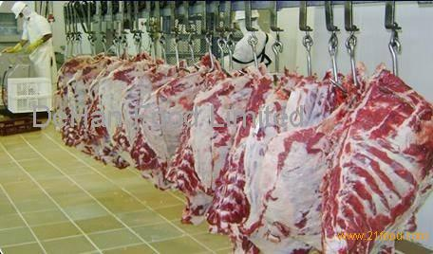
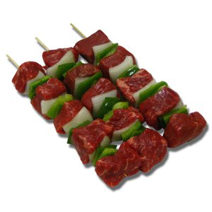
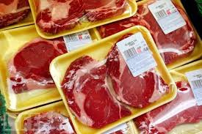
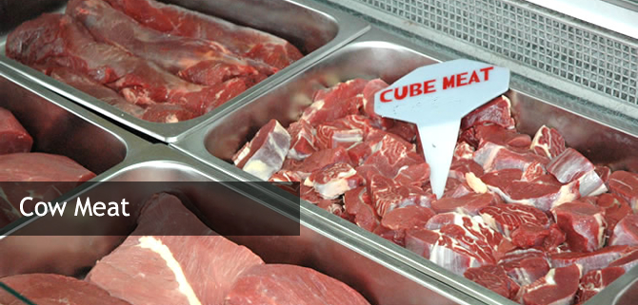
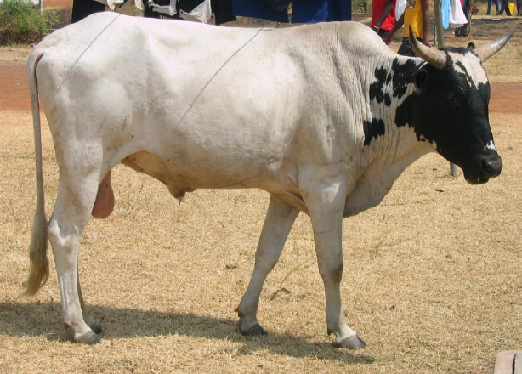
THANK YOU

