Slide 1
Factors affecting household decision to allocate credit for livestock production: Evidence from Ethiopia
Kaleb Shiferaw, Berhanu Gebremedhin and Dereje Legesse
International Livestock Research Institute (ILRI)
International conference on Livestock value chain finance and access to credit
Swazi Spa Conference Center , Ezulwini, Swaziland
February 21 - 23, 2017
Notes:
There MUST be a CGIAR logo or a CRP logo. You can copy and paste the logo you need from the final slide of this presentation. Then you can delete that final slide
To replace a photo above, copy and paste this link in your browser: http://www.flickr.com/photos/ilri/sets/72157632057087650/detail/
Find a photo you like and the right size, copy and paste it in the block above.

Slide 2
Outline of the presentation
Introduction
Conceptual framework
Methods
Results and discussion
Conclusion and implication

Slide 3
Introduction
Access to and proper use of agricultural credit increase agricultural production and improve rural livelihoods (Abdallah, 2016; Gatti and Love, 2006; Shimamura and Lastarria-Cornhiel, 2010).
Encourages technology adoption and agricultural intensification by smallholders.
For example
Removing credit constraints increases agricultural productivity by 75% (Dong et al., 2012)
Increased access to credit increases adoption of agricultural technologies (Abdallah, 2016)

Slide 4
Cont’d
However, smallholders are credit constrained and their use of agricultural credit leaves a lot to be desired.
Access to credit
Use of credit for agricultural activities
Use of credit for Livestock production

Slide 5
Cont’d
Credit (agricultural credit) is one of the tools to improve the agricultural productivity
However, access to credit is limited and non-negligible proportion of household with credit access do not allocate credit for agricultural activities and even less proportion allocate the credit for livestock production.
The usefulness of any agricultural credit apart from its availability depends on its proper allocation.
The aim of this paper is to identify factors that affect allocation of credit for agricultural activities in general and livestock activities in particular.

Slide 6
Conceptual framework
Allocation of credit for agricultural activities can be thought of as involving different stages.
The three equations are:
$$Y_{1i}^{∗}={x_{1i}β}_{1}+ u_{1i}$$
$$Y_{2i}^{∗}={x_{2i}β}_{2}+ u_{2i}$$
$$Y_{3i}^{∗}=x_{3i}β_{3}+ u_{3i}$$
NO
Credit is taken
NO
Credit is used for agricultural activities
YES
NO
Credit is used for Livestock production
YES
Stage-1($Y_{1})$
YES
Stage-2 ($Y_{2}$)
Stage-3($Y_{3}$)

Slide 7
Cont’d
Access to and use of credit are influenced by
Transaction costs of obtaining the loan,
Household ability to repay the loan, and
The expected return from the activities, which the loan is used for.
These in turn are affected by
Household and farm characteristics (HFC),
Access to financial institutions and agricultural services(AIS),
Opportunity cost of factors of production (OCF), and
Community level factors (CLF)

Slide 8
Cont’d
HFC
AIS
(age, sex, edu, land size, etc..)
(distance to credit sources, road, market and access to extension services )
Access and use of agricultural credit
OCF
CLF
(wage rate for off-farm employment )
(population density, availability of grazing land)

Slide 9
Method
The three stages give four possible outcomes
$Y_{1i}$ =0,
$Y_{1i}\text{ =1 }Y_{2i}\text{ =0}$
$Y_{1i}$ =1 and$Y_{2i}$ =1 and $Y_{3i}$ =0
$Y_{1i}$ =1 and$Y_{2i}$ =1 and $Y_{3i}$ =1
Y1
No
Yes
Y2
No
Yes
Y3
No
Yes

Slide 10
Cont’d
Data
The study is based on a cross-sectional baseline data collected for LIVES project for the 2012/13 production year.
The data was collected from February to April 2014 from randomly selected rural households in four regions of Ethiopia (Amhara, Oromia, SNNPR and Tigray).
From the randomly selected respondents, a total of 1,400 reported as having a positive demand for credit. Thus analysis is based on this households.

Slide 11
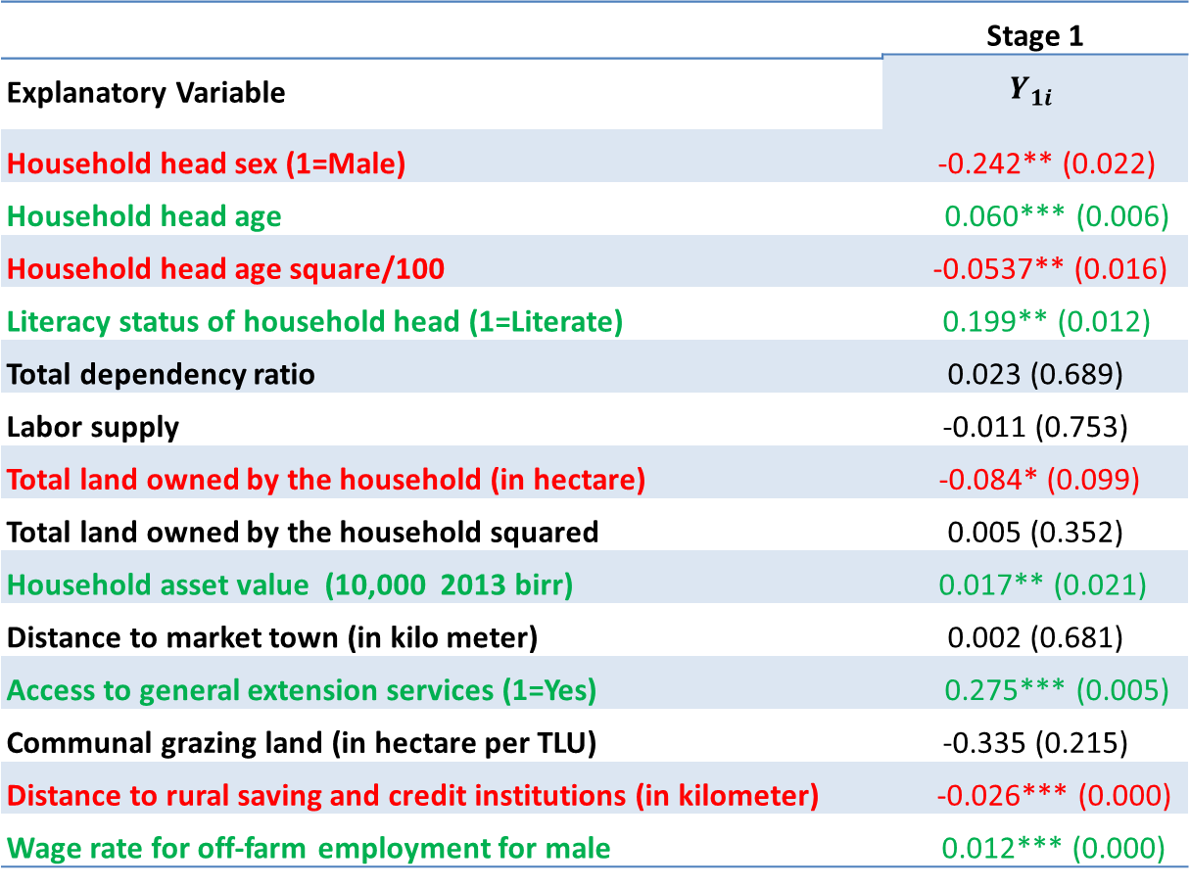
Results and Discussion
 | Stage 1
 | $$Y_{1i}$$
Explanatory Variable
Household head sex (1=Male) | -0.242** (0.022)
Household head age | 0.060*** (0.006)
Household head age square/100 | -0.0537** (0.016)
Literacy status of household head (1=Literate) | 0.199** (0.012)
Total dependency ratio | 0.023 (0.689)
Labor supply | -0.011 (0.753)
Total land owned by the household (in hectare) | -0.084* (0.099)
Total land owned by the household squared | 0.005 (0.352)
Household asset value (10,000 2013 birr) | 0.017** (0.021)
Distance to market town (in kilo meter) | 0.002 (0.681)
Access to general extension services (1=Yes) | 0.275*** (0.005)
Communal grazing land (in hectare per TLU) | -0.335 (0.215)
Distance to rural saving and credit institutions (in kilometer) | -0.026*** (0.000)
Wage rate for off-farm employment for male | 0.012*** (0.000)
$$\frac{∂P(Y_{1i}=1)}{∂x_{edu}}=.070$$
$$\frac{∂P(Y_{1i}=1)}{∂x_{ext}}=.094$$
$P\left(Y_{1i}=1\right)$is 6.3% higher for hh within 1km that hh within 6km

Slide 12
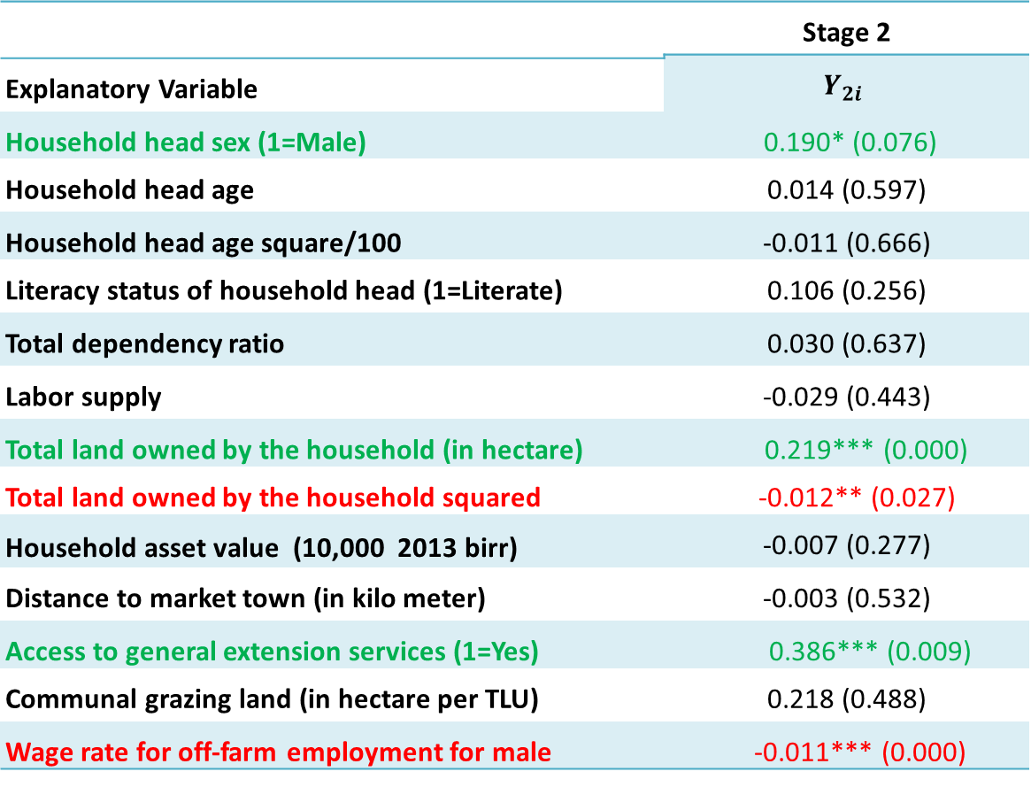
Con’d
 | Stage 2
 | $$Y_{2i}$$
Explanatory Variable
Household head sex (1=Male) | 0.190* (0.076)
Household head age | 0.014 (0.597)
Household head age square/100 | -0.011 (0.666)
Literacy status of household head (1=Literate) | 0.106 (0.256)
Total dependency ratio | 0.030 (0.637)
Labor supply | -0.029 (0.443)
Total land owned by the household (in hectare) | 0.219*** (0.000)
Total land owned by the household squared | -0.012** (0.027)
Household asset value (10,000 2013 birr) | -0.007 (0.277)
Distance to market town (in kilo meter) | -0.003 (0.532)
Access to general extension services (1=Yes) | 0.386*** (0.009)
Communal grazing land (in hectare per TLU) | 0.218 (0.488)
Wage rate for off-farm employment for male | -0.011*** (0.000)
$$\frac{∂P(Y_{2i}=1|Y_{1i}=1)}{∂x_{sex}}=.040$$
$$\frac{∂P(Y_{2i}=1)}{∂x_{sex}}=.058$$
$$\frac{∂P(Y_{2i}=1|Y_{1i}=1)}{∂x_{land}}∗σ_{land}=.087$$
$$\frac{∂P(Y_{2i}=1|Y_{1i}=1)}{∂x_{ext}}=.213$$

Slide 13
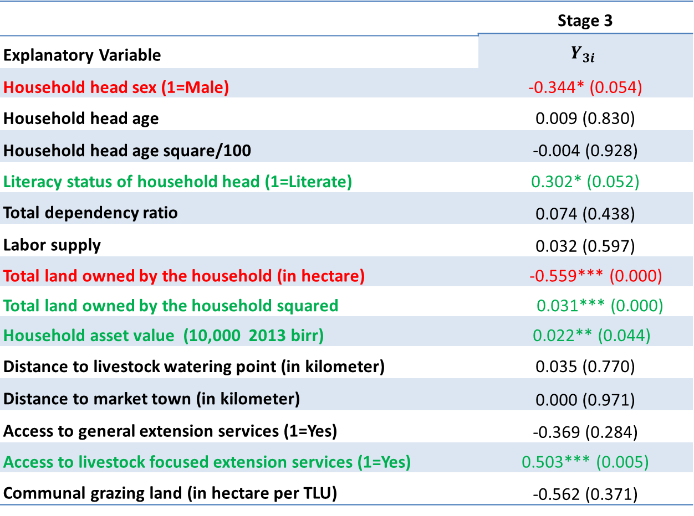
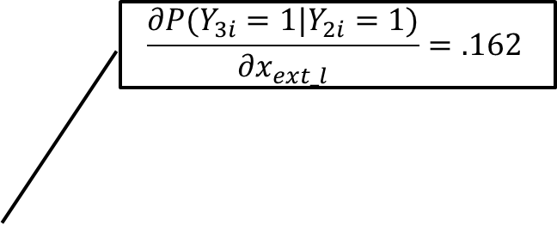
Con’d
 | Stage 3
 | $$Y_{3i}$$
Explanatory Variable
Household head sex (1=Male) | -0.344* (0.054)
Household head age | 0.009 (0.830)
Household head age square/100 | -0.004 (0.928)
Literacy status of household head (1=Literate) | 0.302* (0.052)
Total dependency ratio | 0.074 (0.438)
Labor supply | 0.032 (0.597)
Total land owned by the household (in hectare) | -0.559*** (0.000)
Total land owned by the household squared | 0.031*** (0.000)
Household asset value (10,000 2013 birr) | 0.022** (0.044)
Distance to livestock watering point (in kilometer) | 0.035 (0.770)
Distance to market town (in kilometer) | 0.000 (0.971)
Access to general extension services (1=Yes) | -0.369 (0.284)
Access to livestock focused extension services (1=Yes) | 0.503*** (0.005)
Communal grazing land (in hectare per TLU) | -0.562 (0.371)
$$\frac{∂P(Y_{3i}=1|Y_{2i}=1)}{∂x_{sex}}=−.108$$
$$\frac{∂P(Y_{3i}=1|Y_{2i}=1)}{∂x_{edu}}=.099$$
$$\frac{∂P(Y_{3i}=1|Y_{2i}=1)}{∂x_{ext_l}}=.162$$
$$\frac{∂P(Y_{3i}=1)}{∂x_{ext_l}}=.164$$

Slide 14
Conclusions and implications
Non-negligible proportion of households allocate the credit for non-productive activities such as household expenditure.
Improving access to credit does not automatically translate into more productive households
Female household heads are more likely to allocate credit for livestock production
Extending credit to females may lead to improved households’ access to animal sources foods (ASF)
Literate farmers are liker to allocate credit for livestock production
Improving rural education and literacy can enhance livestock development.

Slide 15
Cont’d
Access to livestock focused extension services has statistically positive effect on farmers’ decision to allocate credit for livestock.
It is possible to increase livestock products and productivity by combining improved access to credit with livestock focused extension service.
‘‘Credit-plus’’ approach, which is availing credit together with support services, ensures proper exploitation of the available opportunities credit access entails.

Slide 16
Thank You for your attention

