Slide 1
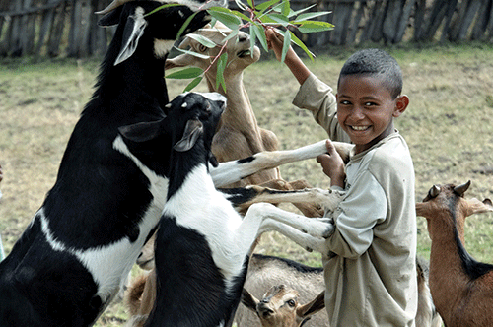
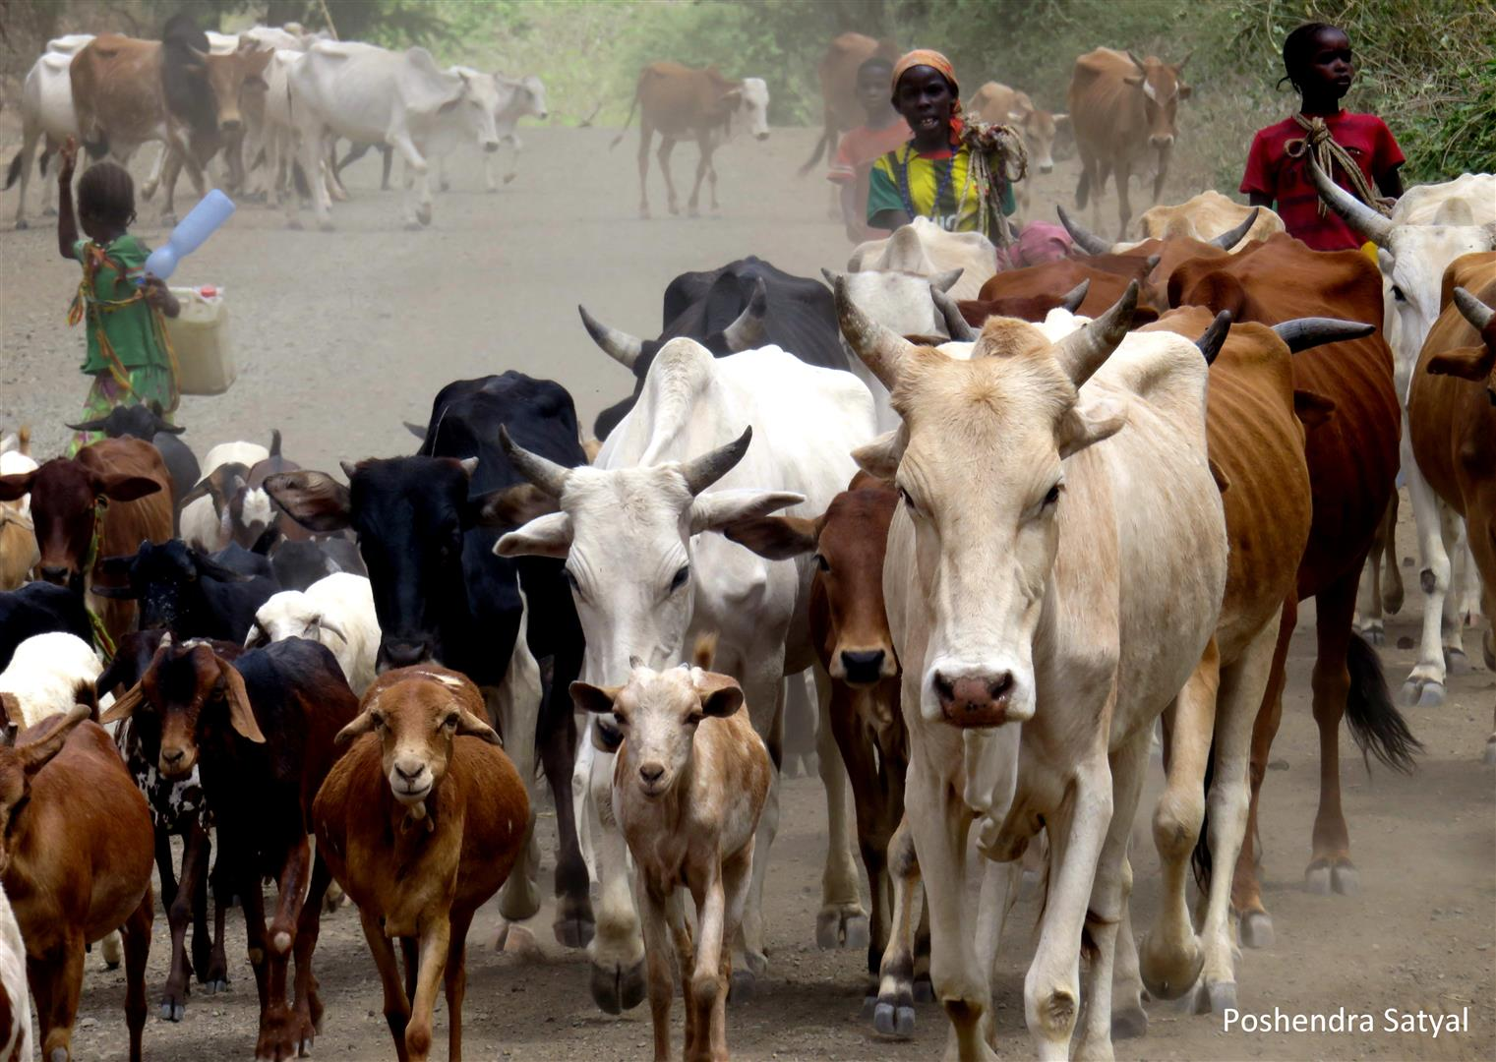
Rural Financial Services and Its Effects on Livestock Production in Ethiopia
Wegayehu Fitawek, Mmatlou Kalaba
International Conference on
Livestock Finance
Royal Swazi Spa, Ezulwini, Swaziland,
21-23 February 2017

Slide 2
Outline
Introduction
Objective
Types of financial services
Impacts of financial services
Challenges of financial services
Conclusion

Slide 3
Introduction
Ethiopia’s economy is based on agriculture:
which contributes 43% of the GDP
80% of employment
generates 75% of the export earnings (NBE, 2015)
Ethiopia is also highly endowed with livestock resources
ranking first in Africa and top ten countries in the world
It have 55 million cattle, 27 million sheep and 28 million goats (CSA, 2013)
an essential part of agricultural GDP (45%)

Slide 4
Introduction
Livestock in Ethiopia are:
closely linked to every social and cultural aspects of both rural and urban households
source of food
source of employment
acts as security assets to get credit
considered as a common means of demonstrating wealth

Slide 5
Introduction
There is huge gap between the livestock resource base of the country and the growth of the sector
livestock production affected by many factors - drought, disease, lack of capital and others
Lack of capital is among the prominent factors in developing countries
government and NGO- more attention to crop production than livestock
Ethiopia has made marked progress in agriculture over the past decade. However, agriculture is a less attractive field for financial sector

Slide 6
Introduction
Financial services are essential for protecting and improving the livelihoods of rural populations
financial service offerings to agricultural sector in Ethiopia face gaps in terms of access and demand
only few financial institutions serve financial services to rural areas
ranks 109th in getting credit out of 189 countries (WB, 2014)
The objective of this paper is to identify the types of rural financial services and to examine its effect on livestock production

Slide 7
Types of Financial Institutions
The main financial institutions:-
banks, microfinance, cooperatives, insurance companies and informal financial institutions
In 2015, total banks in Ethiopia have reached 19 (2,636 branches)
Ethiopia is the most under-banked countries in SSA with bank branch to population ratio 1:35,000 (only 1% of rural households maintain bank account)

Slide 8
Microfinance
Microfinance is the most common for rural areas in Ethiopia
MFIs provide services - collecting and savings, providing group and individual loans, micro insurance and domestic money transfer services
In 2015, there were 33 MFIs (3 million clients)
The top five largest MFIs are: ACSI, DCSI, Oromia Credit & Saving Institute, Omo Credit & Saving Institute and Addis Credit and Savings Institute
Currently, the contributions of MFIs are growing fast
the demand for microcredit is far from the supply, an estimated of 80 percent of rural demand for loans is still uncovered

Slide 9
Cooperatives
Cooperative is the other type of financial institution in Ethiopia
Agricultural cooperatives
increase their yield and incomes of their members
pooling their resource to support collective service and economic empowerment
27,000 multipurpose cooperatives (30% are saving and credit cooperatives)

Slide 10
Informal financial services
Informal financial services- the most important sources of rural finance for the past many decades, currently informal grain and cash loans are decreasing in magnitude and frequency
the major informal sources of finance
- relatives and friends
- local money lenders
- Community Based Organizations (CBOs) like Iqqub and Iddir
Insurance companies
reached 17 with 369 branches (53 % in Addis Ababa)
only few insurance company providing livestock insurance
most of the farmers are not aware of the livestock insurance

Slide 11
Impact of financial services on livestock production
Several studies have been conducted- whether MIFs can really help the poor, but there is no consensus on results and some of them contradict
have positive impacts on the life of the poor
play insignificant role towards mitigating the problem of the poor
The effects of credit on livestock producing households (better off and poor) are different

Slide 12
Impact cont…..
Bamlaku (2004), Getaneh (2007), Kassa (2008) and Mekonnen (2008) a comparative study of ACSI
All these studies results showed that microfinance have positive socio-economic impact on income, asset holiding and their empowerment status
Asmelash (2011) also pointed out that participation in microfinance have a positive impact on the member household income, acquisition of assets, access to education, and access to health facilities

Slide 13
Impact cont…..
Tesfaye (2003) and Hailai (2010), on the impact of Dedebit Credit & Saving Institute (DECSI)
impact of households’ participation in microfinance on reducing poverty and accumulating fixed assets is insignificant
Participation in microfinance help households just to survive in times of shocks and vulnerabilities (for consumption smoothening)
Siyoum (2012), the effect of credit on livestock producing households (better-off and poor) is different
results showed that credit simply helped poor households to cover seasonal food shortages and no impact on long-term productivity and household food security

Slide 14
Impact cont…..
Credit enabled better-off households to buy additional oxen, seed, and fertilizer which helped them to increase their productivity
90% of the rich households bought livestock but only 69% of the poor
Poor households divert part of the loan for other purpose like: consumption smoothing, seed, debt repayment, school fees, clothes, religious and social celebrations, medical expenses and house repairs
Sale of livestock to pay back loans, especially the sale of ploughing oxen- poor households to rent out their land to another farmer
this push poor households further into poverty (49%)

Slide 15
Impact cont…..
Source of credit are different for the two groups
source of credit for poor is mostly come from informal sources (70%), whereas source of credit for rich is mostly from formal
Types of livestock purchased also different between the two groups
the poor acquired small livestock (sheep and goats) whereas the rich invest in large livestock (cows and oxen) for breeding and fattening
difference on household asset creation and asset holdings

Slide 16
Challenges of financial services
Lack of flexibility in the repayment period
Low saving rate (3%)as compared to the lending interest rate (18%)
The amount of loan allowed to take at a time (Birr 3,000 on average)
Lack of collateral (group collateral arrangements)
Lack of proper clinic and veterinary services
Inadequate number of insurance company on livestock sector
Lack of appropriate skill training and lack of follow up of the clients by the financial institutions

Slide 17
Conclusion
Financial services especially loan is important to enhance the welfare and economic situation of its clients
Credit enabled better-off households to buy additional oxen, seed, and fertilizer which helped them to increase their productivity. Credit has not only limited impact in household asset creation but also has a negative impact on poor households’ asset holdings through forcing households to sell their livestock to pay back their loans
Financial institutions have to look over the repayment period, lending modalities as well as the saving interest rate in order to make it attractive and successful
In addition to this, financial institutions should be give attention for other important activities such as training, advice and follow up (before, during and after) loans are necessary

Slide 18
Thank you

