Slide 1
International Conference on Livestock Value Chain Finance and Access to Credit
The role of contracts in improving access to credit in the smallholder livestock sector of Swaziland
Mamba T.X., Machethe C.L. & Mtimet N.
Ezulwini, Swaziland,
21-23 February 2017

Slide 2
Presentation outline
Introduction
Study objectives
Methodology
Results
Conclusions

Slide 3
Introduction
Access to credit is essential for the development of the agricultural sector
The commercial banks are unwilling to participate in the provision of credit to smallholder farmers due to their lack of collateral.

Slide 4
Study objectives
Determine the credit access status of smallholder cattle farmers, fatteners and traders.
Identify factors that determine smallholder cattle farmers’, fatteners’ and traders’ access to credit from formal financial institutions.
Determine whether participating in contracts leads to improved access to credit.
Determine factors that may lead cattle farmers to become involved in contract agreements with other actors in the value chain.

Slide 5
Research hypothesis
Participation in contract farming will improve access to credit for smallholder cattle farmers, cattle finishers and cattle traders in Swaziland.

Slide 6
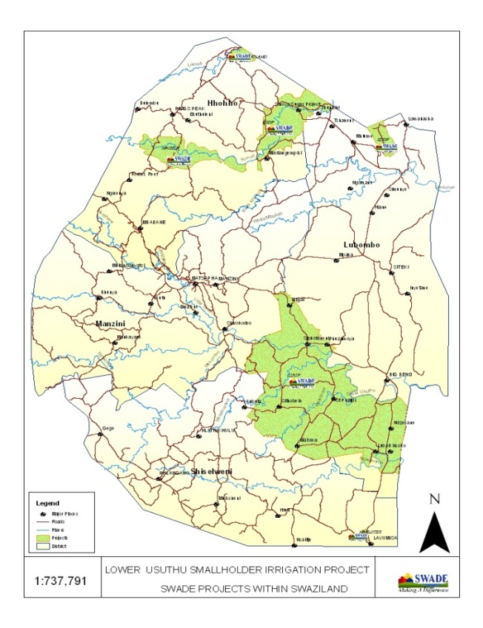
Methodology
FGD: Oct 2013 to Feb 2014 followed by individual interviews up to June 2014
In total 111 persons interviewed (face-to-face):
53 cattle producers
36 cattle fatteners
22 cattle traders
Figure 1. Selected study areas under SWADE project

Slide 7
Methodology
The study involved a descriptive research using quantitative approaches (results were entered in excel and analysed using Spss ver. 20 & Stata 13)
Logistic regression analysis was used to analyse the influence of independent variables on a binary/dichotomous dependent variables: access to credit, and contract agreement

Slide 8
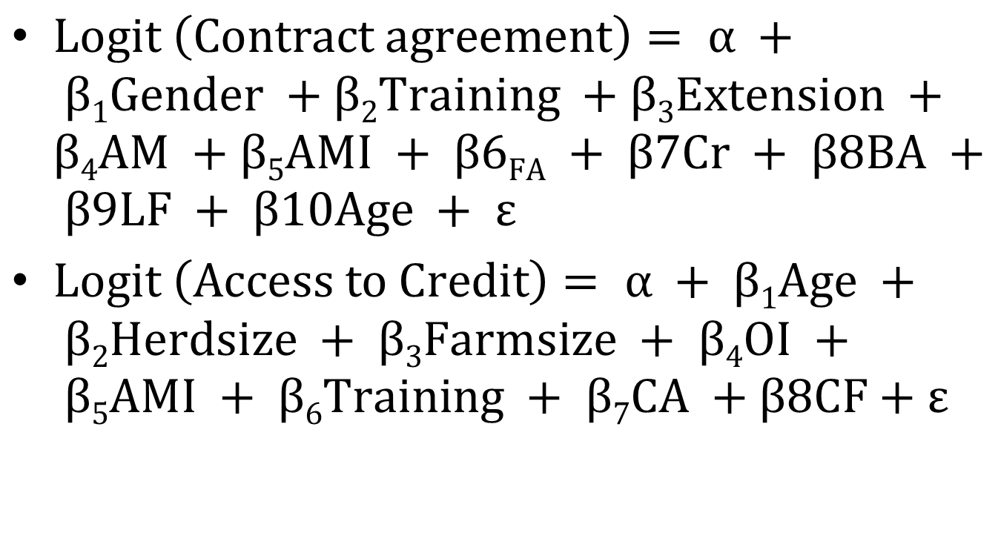
Models

Slide 9
Results Gender, age and education of cattle stakeholders
Variables | Definition | Cattle Producers n=53 | Cattle Finishers n=36 | Cattle Traders n=22
Gender (%) | Male Female | 71.7 28.3 | 55.6 44.4 | 90.9 9.1
Age (years) | Mean* Min/Med./Max | 50.3 (13.12) 28/53/75 | 45.4 (13.24) 21/46.5/70 | 51.32 (11.8) 29/51.5/82
Education (%) | Illiterate Literate Primary Secondary Tertiary | 32.1 9.4 35.9 22.6 0.0 | 25.0 8.3 25.0 36.1 5.6 | 0.0 22.7 50.0 13.6 13.6

Slide 10
Results Factors influencing farmers’ involvement in contract agreements
Variable | B | Wald x2 | p | Odds Ratio
Age | -0.039* | 2.734 | 0.098 | 0.962
Gender | 0.933 | 1.551 | 0.213 | 2.543
Off-farm Income (OI) | 0.483* | 3.698 | 0.054 | 1.620
Access to credit (Cr) | -2.947** | 4.478 | 0.034 | 0.052
Access to market (AM) | 2.770*** | 11.783 | 0.001 | 15.955
Access Marketing information (AMI) | 0.503** | 4.975 | 0.026 | 1.654
Extension Bank Account (BA) Loan Facility (LF) Association Member (FA) | 1.482** -1.835 2.007 2.576** | 4.058 2.599 1.942 5.658 | 0.044 0.107 0.163 0.017 | 4.404 0.160 7.441 13.142
Constant | -3.914** | 5.418 | 0.020 | 0.021

Slide 11
Results Factors influencing farmers’ access to formal credit
Variable | B | Wald x2 | p | Odds Ratio
Herd size (Hsize) | -0.048** | 5.904 | 0.015 | 0.954
Age | 0.045** | 5.019 | 0.025 | 1.046
Training | 1.144** | 4.725 | 0.030 | 3.140
Farm size (Fsize) | 0.070 | 0.613 | 0.434 | 1.073
Income | 0.335* | 3.208 | 0.073 | 1.397
Contractual agreement (CA) | 0.634 | 1.373 | 0.241 | 1.885
Marketing information (AMI) Cattle fattening (CF) Constant | -0.122 -0.634 -2.931** | 0.520 0.716 6.479 | 0.241 0.397 0.011 | 0.885 0.530 0.053

Slide 12
Conclusions
Contract participation
Assist farmers to receive better education, gain access to timely and quality inputs such as extension services, markets, and institutional/formal credit, and receive better opportunities for off-farm income to improve financial status.
Promote non-political farmers’ organisations to improve smallholders’ bargaining power, as well as reduce transaction costs with agribusiness companies.

Slide 13
Conclusions
Access to credit
There is at present limitation in accessing credit attributable to the strict requirements for accessing loans
The physical absence of regulatory enforcement in the financial market seriously militates against farmers’ chances of accessing credit from formal institutions.

Slide 14
Conclusions
Contract participation in improving access to credit
The contract participation model has revealed that having access to credit is essential in integrating smallholder cattle farmers into the overall economy
Smallholder farmers have credit constraints but if they have access to credit from FFI there is no need for farmers to be involved in contractual agreements.
Access to credit model revealed that participation in contracts does not lead to improvement in access to credit from formal financial institution

Slide 15
Thank you

