Slide 1
“Models of inclusive value chain financing and investment for livestock”
Calvin Miller
International Conference on livestock value chain finance and access to credit: Improving smallholders’ livestock value addition and marketing through access to finance and credit”.
Swaziland, 21st to 23rd February 2017

Slide 2
Outline
Models of inclusive value chain financing and investment for livestock
Finance and investment for livestock
  Livestock as a source and use of finance
  Livestock value chains
  Conventional livestock finance
  Bottlenecks restricting finance for the livestock sector
Value chain finance
  Defining agricultural VC finance
  Livestock VC finance
Lessons

Slide 3
Enhancing Rural Livelihoods
Enhancing Rural Livelihoods
Improve rural incomes
through market-oriented,
profitable and resilient
enterprises
Human & institutional
capacity building
Marketing system
development
Policy & program
decision support
Rural Income
Food and Other
Financial services
Food Security
Agricultural Products
Resilience

Slide 4
Livestock investment and finance
The role of livestock
  A store of value – savings bank
  A source of cash flow leveling
  An intrinsic social status representation of wealth
  A household insurance and risk mitigator
  A business investment and income generator
  A source of value addition and complement to crop farming – labor, manure, residue recycling, cooking fuel
  A critical source of food and income generation for women and families

Slide 5
Key Challenges for Livestock Finance
Vulnerability Constraints
Production Risk
Market Risk
Credit Risk
Capacity Constraints
Technical capacity risk
Social risk
Institutional capacity risk
    Financing Constraints
    Risk - Price, death, competitiveness, weather, bio-security and disease, theft
    Transaction costs for obtaining financing
    Lack of long-term financing/ investment
Operational Constraints
Unstable, slow returns on investment
Low levels of assets and investment
High costs of services
Economic Environment Constraints
Political and social interference
Regulatory, safety and quality risks
Land and natural resource rights
Notes:
Systemic Risk – rural incomes, especially among the agriculturalists, are highly susceptible to similar risks at the same time. Weather is the most uncontrollable and often devastating risk but disease and plagues are similarly important. Failures in agriculture affect not only the farmer households and the production and marketing linkages but also the rural non-farm economies that revolve around and depend upon those income flows. Even so, the most problematic is farm credit because of higher risk.
Market Risk – especially in developing countries, there both cyclical and seasonal price fluctuations of agricultural commodities, not only due to local production variation but also affected by “outside forces” such as political price and exchange controls, subsidies and globalization.
Credit Risk – collateral, especially mortgage, is a missing element in most rural finance hence increasing the risk of the lender. Similarly collateral substitutes may be costly in both financial terms as well as social stigma risk terms as can be the case with peer lending. Other support services and information networks such as credit bureaus are often not available to help lower the risk. For term lending, a financial gap risk between sources and uses of funds poses another risk constraint.

Slide 6
Looking ahead – is it a good investment?
Yes
As incomes rise, more meat is consumed
It has a more predictable income flow with less sharp losses
It complements labor seasonality of other agricultural activities
It can recycle crop residuals and make use of otherwise unproductive resources
Animal traction for power and transport
No
Standards, tracing and certifications make it harder for small farmers
Improper management can lead to significant losses of both animals and natural resources
Returns are generally low and slower than alternative investments

Slide 7
Where to invest in the livestock industry?
Improved genetics
Improved fencing, sheds
Increased pasture or feed
Increased herd size
Bio-tech – improved conversion rates, etc.
Support services – vet services, early warning, theft control
Capacity development and training
Improved infrastructure – logistics, slaughter facilities, dairies and milk infrastructure
Industry integration
Production
Agri-processing
Animals
Storage/ logistics
Technology/Bio-tec

Slide 8
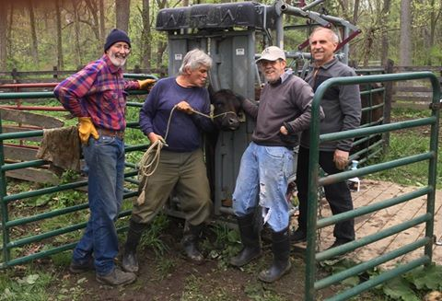
How to invest in the livestock sector?
Personal equity and savings
Reinvested earnings (both sales income and herd growth)
Investment partners
Loans
Through forward contracts and futures financing
With financing from value chain partners

Slide 9
Defining agricultural value chain finance
Agricultural value chain finance (AgVCF) – financial products and services flowing to and/or through an AgVC to address the needs of those involved in that chain, be it a need for finance, a need to secure sales, procure products, reduce risk and/or improve efficiency within the chain.
Objectives:
Align and structure financial products to fit the chain
Reduce costs and risks of finance
9

Slide 10
All stakeholders have a role in VCF management
Systemic risks
Regional and idiosyncratic risks
Input
Food
Food
Input
Suppliers
Growers
Transport
Storage Services
Processing
Retail
CONSUMERS
Suppliers
Industries
Industries
Production
Logistics & VC Services
Agri-food Industries
Financial Services
Financial Services
Business Support Services
Operating Environment
10
Notes:
Brief overview of the external support services that can be provided to the different actors at the different stages

Slide 11
Value chain finance approach
VCF is an approach with application of selected instruments and adaptions based upon:
A chain focus – looking at all actors, processes and markets of the chain
A transaction focus – product and cash flow and its opportunities and risks
Risk mitigation and efficiency – lending on the strength of those with stronger backing
Direct and indirect financing -- according to efficiency, often with in-kind disbursements and payments at point of sale
11

Slide 12
Value chain business models
Business models for agriculture and livestock value chains in terms of small holders can be divided into four types:
      Producer-driven
      Buyer-driven
      Facilitated
      Integrated

Slide 13
Benefits of Value Chain Finance
Value Chain Finance can improve the overall effectiveness and efficiency of the value chain by:
  using relationships along the value chain
  mitigating risks and constraints
  exploring business-financial institutions strategic partnering
When designed well, value chain finance can increase the competitiveness of small producers and herders, as well as the range of livestock agribusiness enterprises linked with them.

Slide 14
Who benefits from value chain finance?
  What are the potential benefits of a value chain approach?
    For livestock and producer organizations
    For agribusiness firms – butcheries, meat retailrs, tanneries, shoemakers
    For financial Institutions
    For governmental research and extension
  What are the main risks of focusing on value chains?
  How can these be addressed?

Slide 15
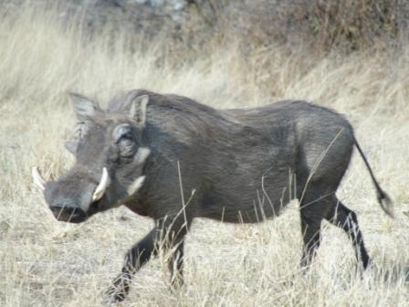
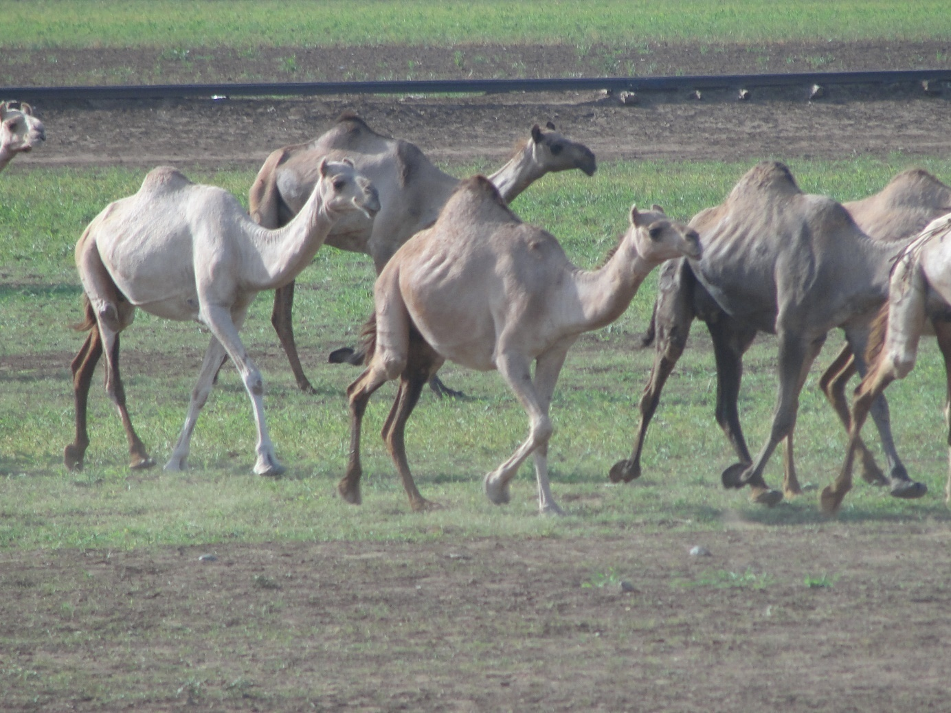
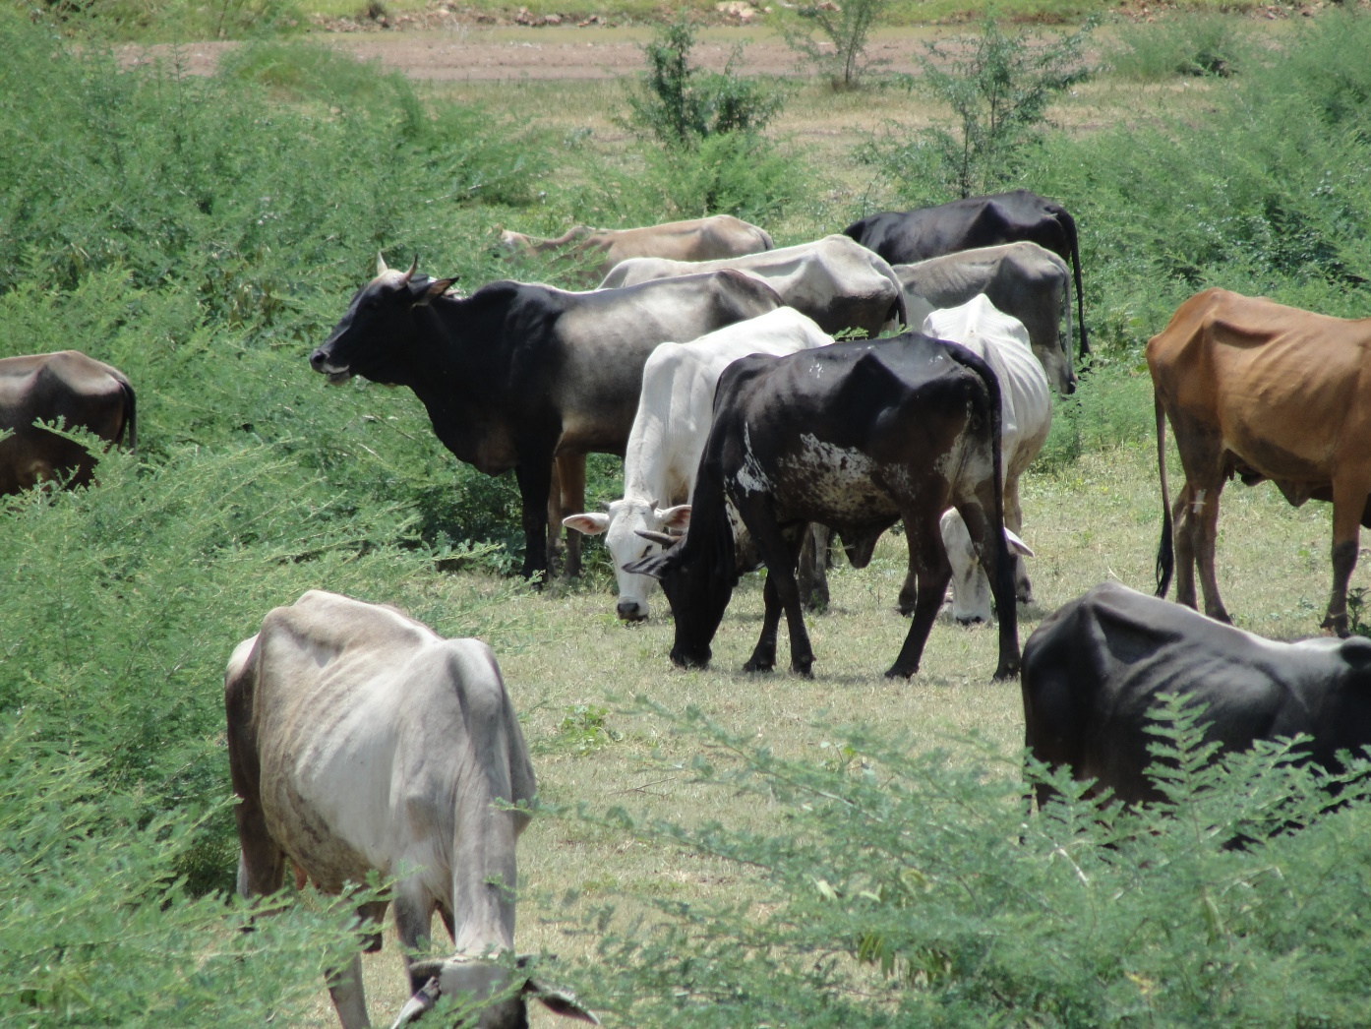
Examples of Livestock VC finance
    Models, instruments and applications for livestock finance and investment
    Investment in natural resource management and infrastructure

Slide 16
East Africa dairy sector improvement finance
The East Africa Dairy Development (EADD) program is designed to boost the milk yields and incomes of small-scale farmers in Africa (Kenya, Uganda and Tanzania). It helps farmers to improve dairy production and access to markets over the next two years.
In its first five years, EADD provided extensive training on dairy husbandry, business practices and operation, and marketing of dairy products to the 179,000 farming families in the program. Heifer and its partners also developed 27 milk collection hubs, strengthened 10 existing hubs, and formed 68 farmer business associations to manage the plants. EADD has now grown to be one of the leading market-oriented development initiatives in eastern Africa.
Building on the success and lessons learned in Phase I, EADD II has refined and improved the hub approach. Small-scale dairy farmers buy shares in a milk chilling hub through a regional business association. Through that hub they sell a dependable, quality supply of milk to dairy processors and receive income in return. They also gain access to banks and credit as well as private goods and services they need to sustain and grow their dairy businesses.

Slide 17











Yes Bank, India - Dairy at Integrated Agricultural Food Park: Information, Product & Financial Flow
Information Flow
Veterinary Services, Training, Technical Knowledge, Market Information
}
Retail
Product Flow
{
Cattle + Fodder
Dairy Products
Milk
Distribution Centre
Consumers
Payment (Milk+Fodder-Loan-Feed)
Payment from the market
Modern Livestock Farm
Feed
Domestic Markets
Payment of Milk (Market Price)
AFP
Cattle Loan
Farmers
Payment Of Cattle Feed (Market Price)
Cattle Loan Repayment
Margin Money
Export Markets
Financial Flow
Bank

Slide 18
Steward Bank - Zimbabwe
‘Cattle banking’ – In Zimbabwe, Steward Bank has introduced a new strategy to farmers who are mostly rural. Cattle are very important assets in the rural areas despite the challenge of climate change and global warming that have direct negative effects on pastures.
The production credit facility serves the purpose to finance acquisition of breeding stock like cattle and sheep, dairy cows and sows and boars. The repayment should never exceed productive life of the asset and with a maximum of 7 years for beef and dairy, 5 years for sheep and 3 years for breeding sows. Internet banking

Slide 19
Livestock Trust bank in Zimababwe
Livestock is deposited to the bank for a certificate that can help a client to access a loan from the bank. Veterinary officials assess the cattle and their value in money before a transaction is closed. Key metrics are health, age, weight, and breed.
A cattle owner can get loans of the commensurate value of cattle deposited to the bank. The bank can provide transport.
The bank pays 10% interest per year on the value of the cattle, which can be paid in cash or additional cows. Owners have the option to get back their cattle after the initial two years or to leave them with the bank for longer.
If the owner fails to repay the loan, the bank possesses the animal. The bank has the right to slaughter aging cattle to sell beef and replace them with cattle of the same value. In the event that the owner dies, a close family member takes over the payment of the loan.
The bank carries out breeding programmes and (can negotiate to keep the calves of cows deposited).

Slide 20
Cidre in Bolivia – cattle registries as collateral
Process | Registry
Demonstrate right of ownership | Registry of book of farmers’ association Signing of ownership declaration
Property documentation | Tag or herd with corresponding number of cattle association Copy of the signed declaration of the community or a judicial authority
Valuation of the cattle or animals pledged | Technical officer of cattle association Credit officer
Management of the Registry and Complaints | Cattlemans’ association Authorities Ownership rights
Legal execution | Judicial execution according to the Civil Code

Slide 21
Risks and tools to mitigate market risks for financing
Risks
A. Production Risk
B. Price Risk
C. Market Risk
D. Financial Risk
Tools
Use of forwards, futures and options
Warehouse receipt finance
Market information services
Contract farming
Insurance
Access to technical assistance
Guarantees
Some risk management tools are more practical for agro-industries and wholesalers, but can stabilize prices and reduce risks for all producers and bankers.

Slide 22
Livestock Insurance
Most livestock is covered under the livestock insurance policies adopted in different countries.
Under such policies, cover is provided for the sum insured or the market value of the animal/livestock at the time of death (whichever is less). Animals are normally insured for up to 100 percent of their market value.

Slide 23

What is the role of development agencies to support implementation of financing arrangements?
Organizing the value chain
Promote integrated business models and contract production
Promote regular market linkages along supply lines
Providing information on VC structure, markets and business models
Supporting integrated arrangements (biz development / finance)
Promoting VC contracts & linkages and farm produce as soft collateral
Provide critical services reducing transaction cost and risk
Supporting micro entrepreneurs and farmers
Training in entrepreneurship and financial literacy
Strengthening co-operatives to promote inclusion in business models
Supporting financial service providers / FIs
Training in VC concept, agricultural production and markets
Develop new financial products
Support introduction of (micro) insurance services

Slide 24
FAO Risk Avoidance Support
The FAO H5N1 HPAI project (Highly Pathogenic Asian Avian Influenza A (H5N1) from poultry
Safeguard the livelihoods and the food and nutrition security of the populations of West and Central Africa and to preserve human lives, through.
Strengthening the preparedness and response capacities of local Governments to prepare and respond to H5N1 HPAI and other AI virus subtypes;
Enhancing cross-sectoral and regional coordination for immediate and effective prevention and control of HPAI in West and Central Africa,
Identifying and mapping out risk factors for virus introduction and spread in the region; (iv)Improving risk-based surveillance in zones most at risk; and
Supporting surge teams for rapid response activities.

Slide 25
Designing Value Chain Financing Solutions: Steps in the Process
Phase 1
Conduct AgVC Analysis
Phase 2
Analyse interests and capacities of actors
Phase 3
Design financing strategy
Phase 4
Implement and monitor the strategy
Step 1
Map the chain & analyse strategies
Step 1
Diagnose interests and capacities of AgVC actors
Step 1
Design alternative mechanisms of financial linkages
Step 1
Formalize working agreements
Step 2
Map the flow of internal and external finance
Step 2
Diagnose interests and capacities of financial service providers
Step 2
Identify allies and explore potential partnerships
Step 2
Design action plans (activities, responsibilities, deadlines, etc.)
Step 3
Identify and prioritize the critical gaps in financing flows
Step 3
Evaluate the implementation and model
Step 3
Identify constraints to financing
Step 3
Design a financing strategy and model

Slide 26
Enabling environment for livestock finance
1. Standards and certification
Quality and safety standards has emerged as a major driver in the integration of agricultural value chains has come from the introduction of quality and safety standards and the demands for strict compliance by buyers of agri-food products.
2. Regulation and enforcement
Regulation for supporting AgVCF is two-fold. It is important for setting the guiding principles for agribusiness as well as for the rules that govern finance.
3. Macro-economic and social context
Financing in agriculture has been susceptible to political interests, to which AgVCF is not immune. However, financing along the chain, secured by the product, is less affected by loans being forgiven or interest rate specifications, since these are commonly imbedded into the marketing contracts

Slide 27



What is the role of the livestock industry regarding climate smart agriculture?
SUSTAINABLY INCREASING PRODUCTIVITY AND INCOME
ADAPTING AND BUILDING RESILIENCE TO CLIMATE CHANGE
REDUCING AND/OR REMOVING GREENHOUSE GASES EMISSIONS
An approach to developing the technical, policy and investment conditions to achieve sustainable agricultural development for food security under climate change.
What can financing climate change adaptation do for the livestock industry?
27

Slide 28
Lessons and recommendations
  What have we learned?
  Recommendations
      Governments and policy makers
      Development agencies
      Financial institutions
      Researchers
      Farmers and farmer organizations

Slide 29
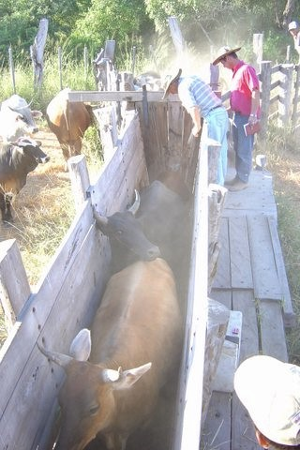
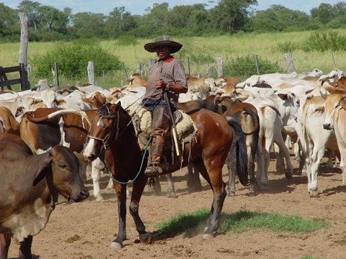
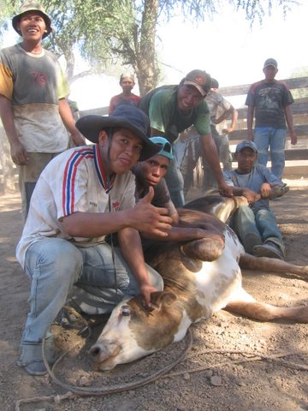
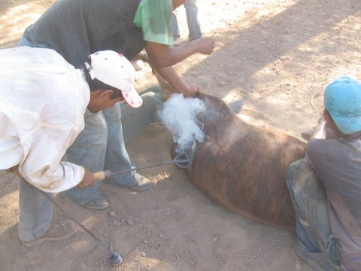
Paraguay Indigenous Foundation

Slide 30
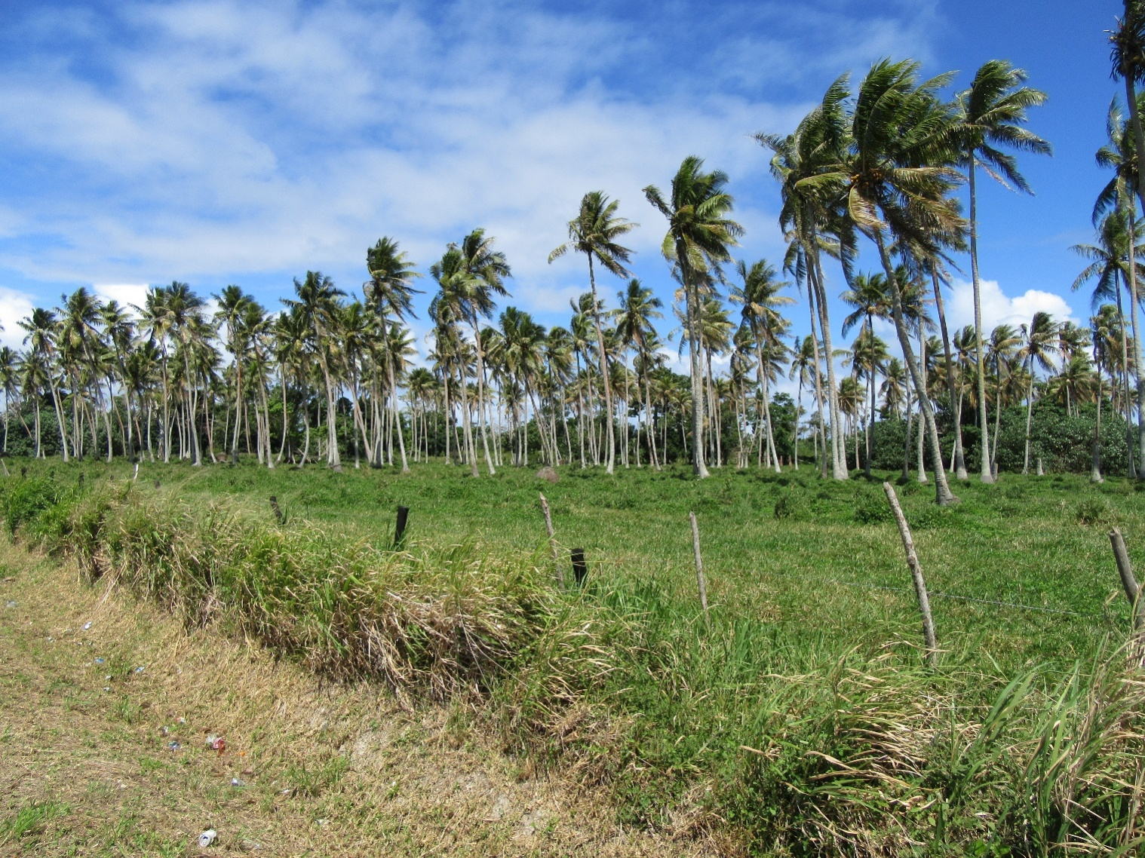
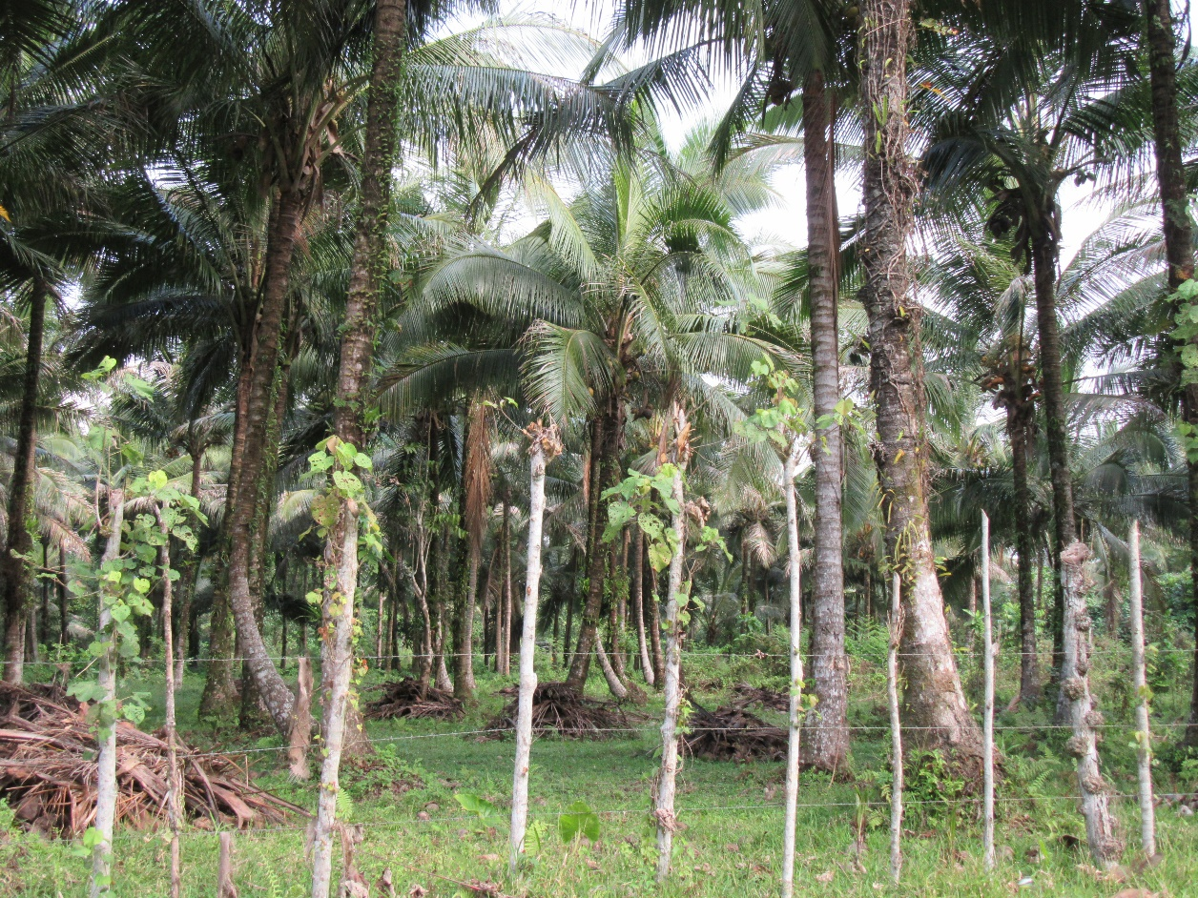
Vanuatu, South Pacific – cattle and coconuts

Slide 31
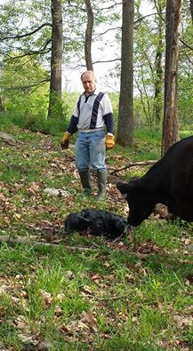
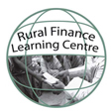
THANK YOU
Calvin Miller calvinjmiller@gmail.com
  Rural Finance and Investment Learning Centre
  www.ruralfinanceandinvestment.org
Contract Farming Resource Center
  www.fao.org/ag/ags/contract-farming/en/

